Slide 1
The ML Problem

Slide 2
Problem Formulation
The aim is to predict the decay rate of heterozygosity for a given landscape. It takes a lot of time to calculate heterozygosity decay for a given landscape (21 hours for the 1000 data points we have now).
The carrying capacity is the same in each patch where individuals can live. There is no selection. Hence, the only way to distinguish two landscapes is the transition matrix, T.

Slide 3
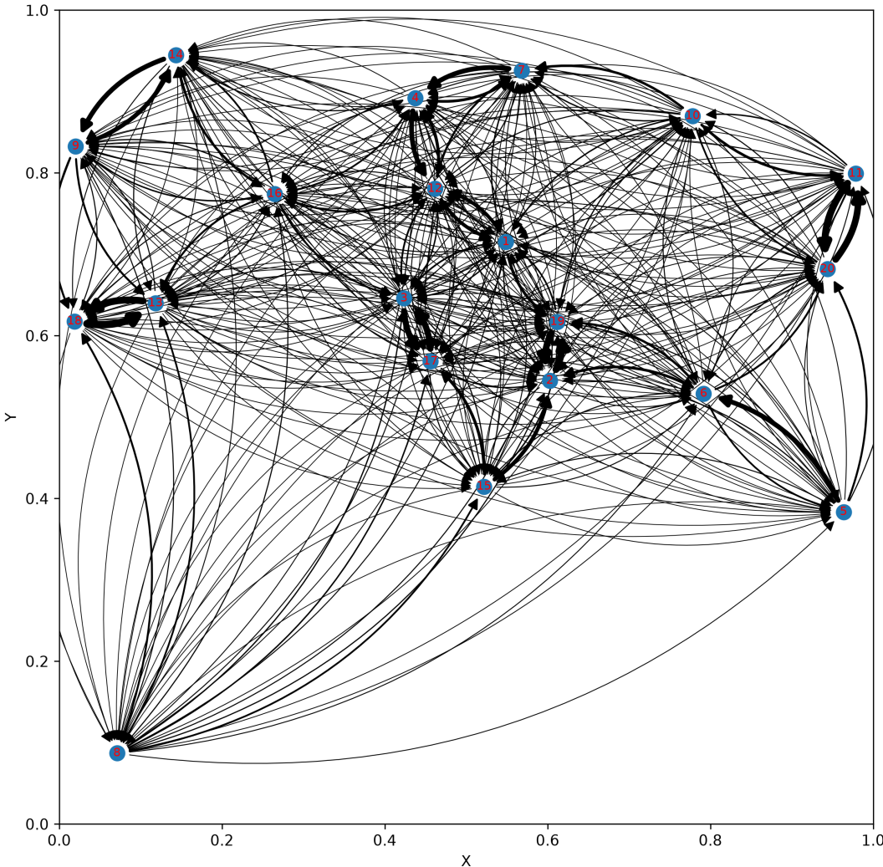
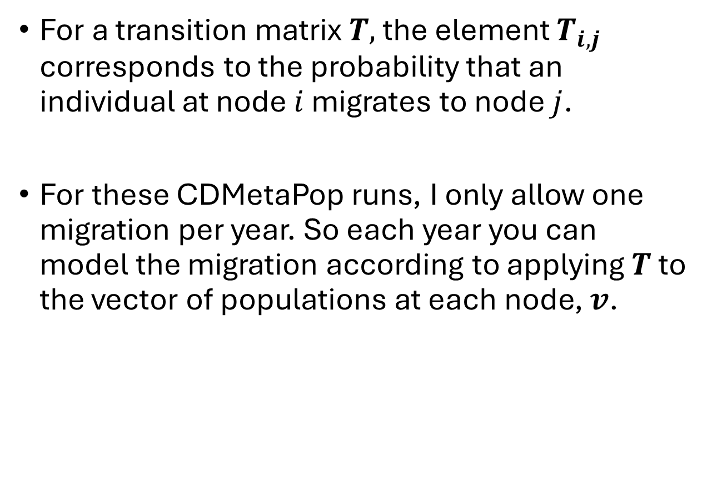
Input: Landscape Transition Matrix
For a transition matrix $T,$ the element $T_{i,j}$ corresponds to the probability that an individual at node $i$ migrates to node $j$.
For these CDMetaPop runs, I only allow one migration per year. So each year you can model the migration according to applying $T$ to the vector of populations at each node, $v$.

Slide 4
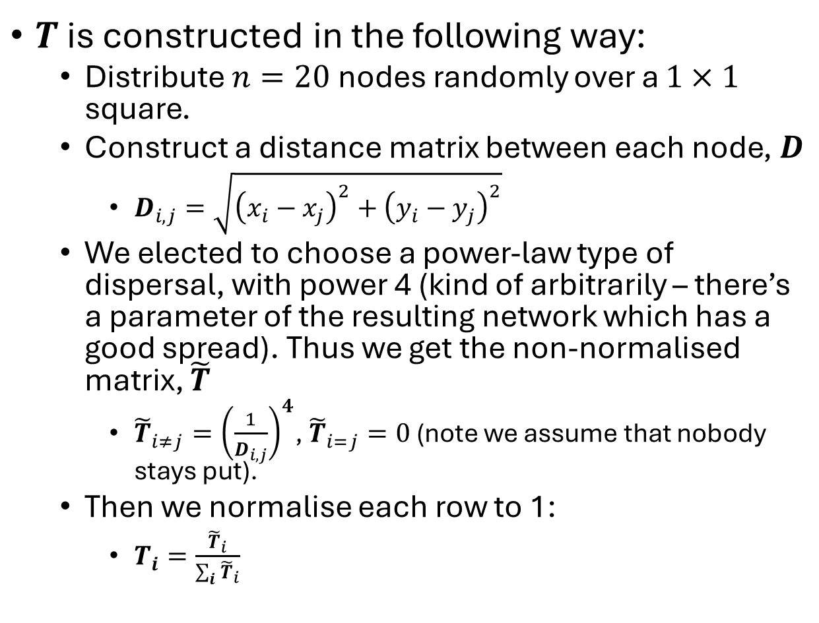
Input: Landscape Transition Matrix
$T$ is constructed in the following way:
  Distribute $n=20$ nodes randomly over a $1×1$ square.
  Construct a distance matrix between each node, $D$
    $D_{i,j}=\sqrt{{\left(x_{i}−x_{j}\right)}^{2}+{\left(y_{i}−y_{j}\right)}^{2}}$
  We elected to choose a power-law type of dispersal, with power 4 (kind of arbitrarily – there’s a parameter of the resulting network which has a good spread). Thus we get the non-normalised matrix, $\tilde{T}$
    ${\tilde{T}}_{i≠j}={\left(\frac{1}{D_{i,j}}\right)}^{4}$, ${\tilde{T}}_{i=j}=0$ (note we assume that nobody stays put).
  Then we normalise each row to 1:
    $T_{i}=\frac{{\tilde{T}}_{i}}{\sum_{i}{{\tilde{T}}_{i}}}$

Slide 5
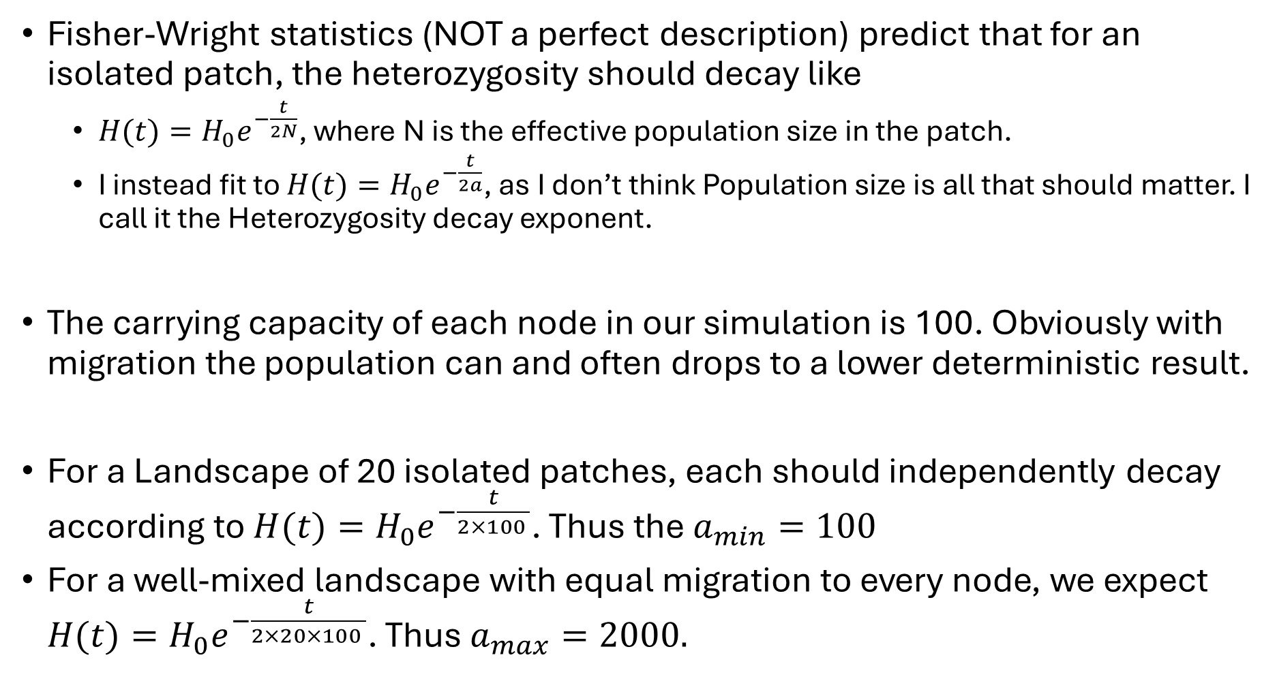
Output: Heterozygosity decay exponent
Fisher-Wright statistics (NOT a perfect description) predict that for an isolated patch, the heterozygosity should decay like
  $H(t)={H_{0}e}^{−\frac{t}{2N}}$, where N is the effective population size in the patch.
  I instead fit to $H(t)={H_{0}e}^{−\frac{t}{2a}}$, as I don’t think Population size is all that should matter. I call it the Heterozygosity decay exponent.
The carrying capacity of each node in our simulation is 100. Obviously with migration the population can and often drops to a lower deterministic result.
For a Landscape of 20 isolated patches, each should independently decay according to $H(t)={H_{0}e}^{−\frac{t}{2×100 }}$. Thus the $a_{min}=100$
For a well-mixed landscape with equal migration to every node, we expect $H(t)={H_{0}e}^{−\frac{t}{2×20×100 }}$. Thus $a_{max}=2000.$

Slide 6
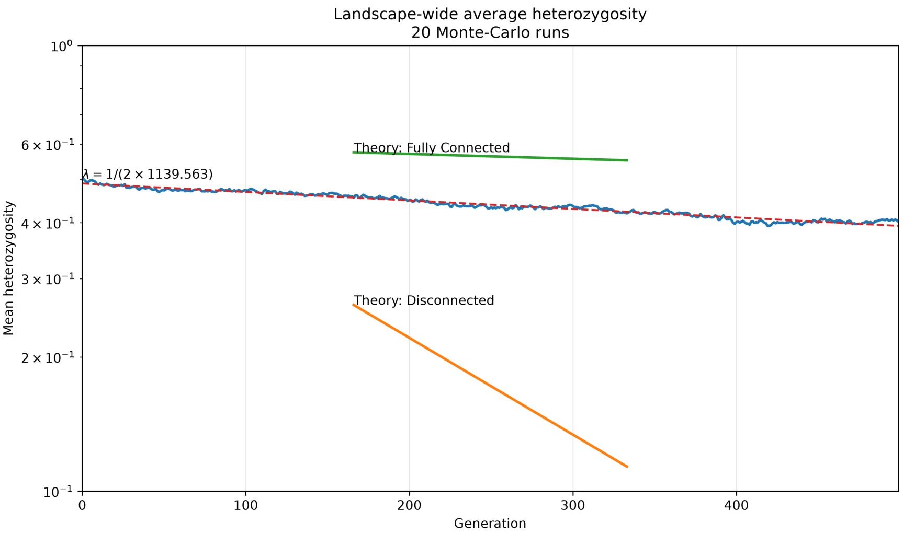
Output: Heterozygosity decay exponent
With a randomly connected landscape, I have yet to find a deterministic prediction for heterozygosity decay. But there is still an (approximate, in some cases) exponential decay in heterozygosity. The result below is averaged over 20 repetitions, so there is a lot of noise.

Slide 7
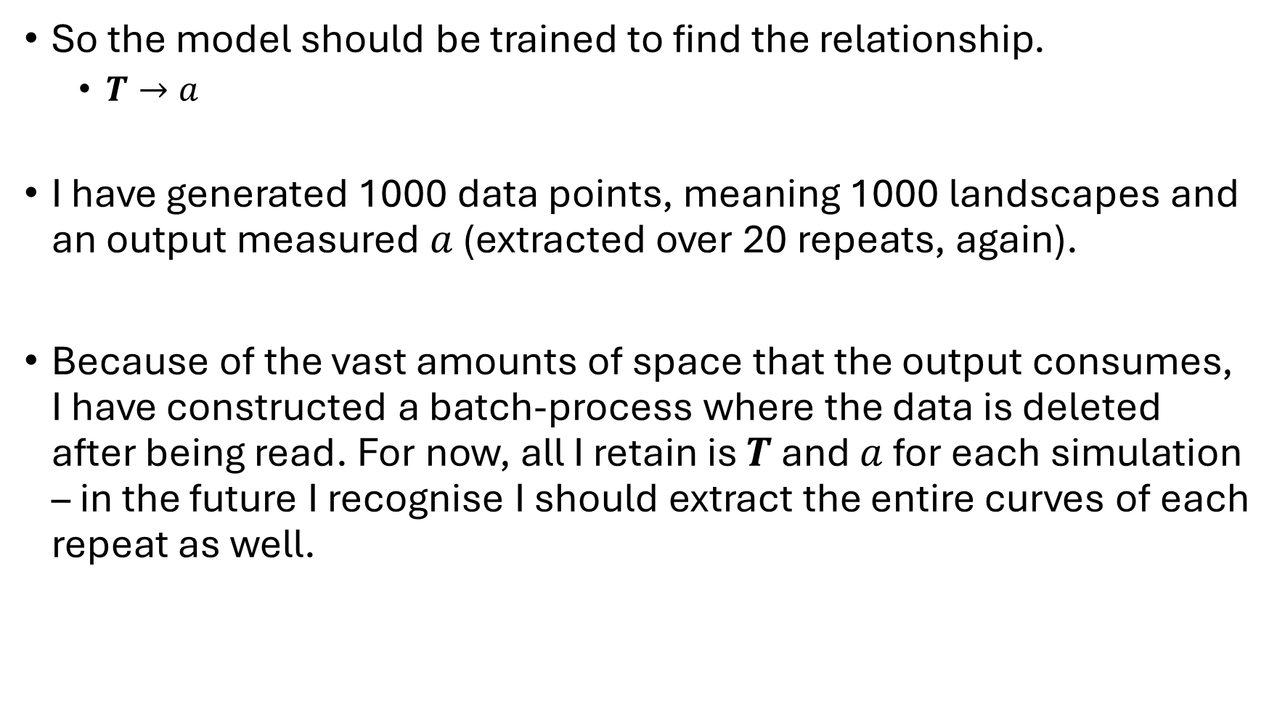
Data
So the model should be trained to find the relationship.
  $T→a$
I have generated 1000 data points, meaning 1000 landscapes and an output measured $a$ (extracted over 20 repeats, again).
Because of the vast amounts of space that the output consumes, I have constructed a batch-process where the data is deleted after being read. For now, all I retain is $T$ and $a$ for each simulation – in the future I recognise I should extract the entire curves of each repeat as well.

Slide 8
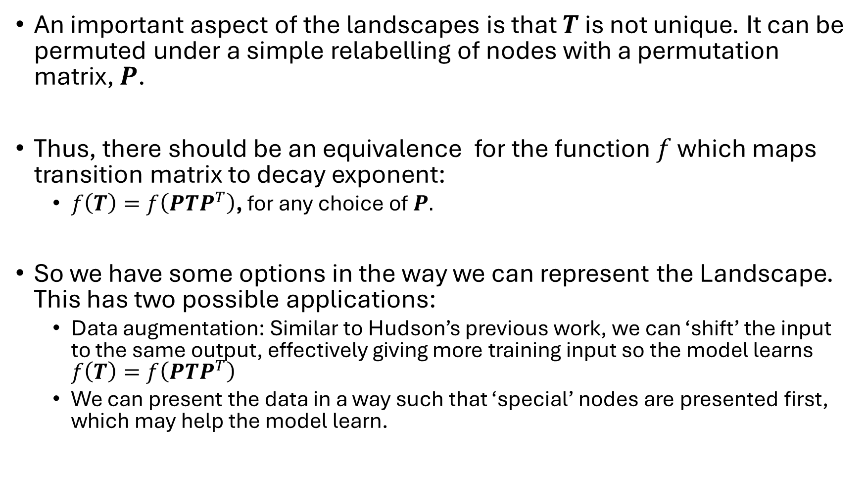
Data
An important aspect of the landscapes is that $T$ is not unique. It can be permuted under a simple relabelling of nodes with a permutation matrix, $P$.
Thus, there should be an equivalence for the function $f$ which maps transition matrix to decay exponent:
  $f\left(T\right)=f\left(PTP^{T}\right)$, for any choice of $P.$
So we have some options in the way we can represent the Landscape. This has two possible applications:
  Data augmentation: Similar to Hudson’s previous work, we can ‘shift’ the input to the same output, effectively giving more training input so the model learns $f\left(T\right)=f\left(PTP^{T}\right)$
  We can present the data in a way such that ‘special’ nodes are presented first, which may help the model learn.

Slide 9
Data
I have a data_format.py script. It is executed with:
  uv run data_format.py -d SaveFiles/n20_ProbDist_Power_param1_4_repeats_1000/ -shufflenum 2
This targets the original output, Analysis_Results.npz, and outputs two files:
  Analysis_Results_Shuffled.npz: Returns a list of Transition Matrices and their corresponding decay exponents, where each Transition Matrix have been shuffled shuffle_num times. This basically multiples the data by shuffle_num.
  Analysis_Results_Sorted.npz: Each Transition Matrix is sorted such that the first node has the largest input from other nodes (the largest column sum), and his decreases with increasing node number.

Slide 10
Data: Issues
Normalisation:
  Each Transition Matrix has elements necessarily less than 1, and the decay exponent should be around 100 to 2000. So I think the decay exponent should be logged for the sake of clean output.
The data is inherently noisy due to the stochasticity. Therefore the fitting is not necessarily great: indeed, we sometimes get decay exponents larger and smaller than the predicted maximum and minimum predicted.
The input Transition Matrices are necessarily size 20x20. This means that there are 400 inputs per output, but only 1000 data points. I suspect this is not enough.

Slide 11
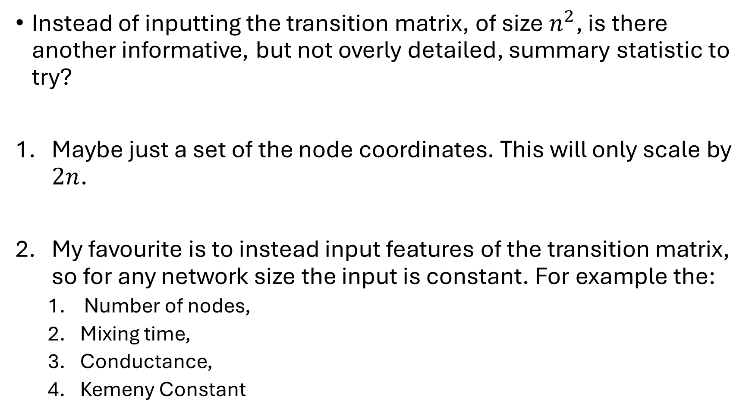
Input: Alternative representations?
Instead of inputting the transition matrix, of size $n^{2}$, is there another informative, but not overly detailed, summary statistic to try?
Maybe just a set of the node coordinates. This will only scale by $2n$.
My favourite is to instead input features of the transition matrix, so for any network size the input is constant. For example the:
  Number of nodes,
  Mixing time,
  Conductance,
  Kemeny Constant

